Slide 1
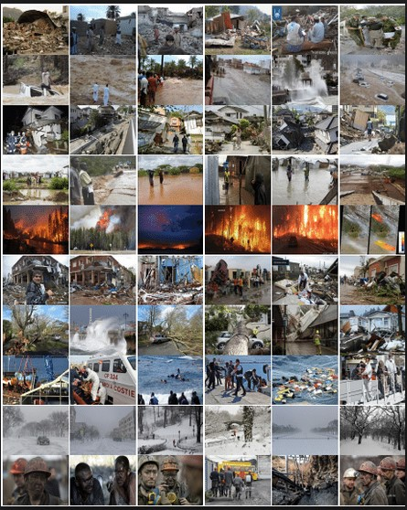
NATURAL CALAMITIES Or DISASTER:
Who is responsible for it ?
Submitted To:-
Faculty Name :- Varinder Kaur
Made By:-
Name:- Ashwani Kumar
Roll No. :- RK18PGB41
Section:- K18PG
Subject:- PEL131

Slide 2
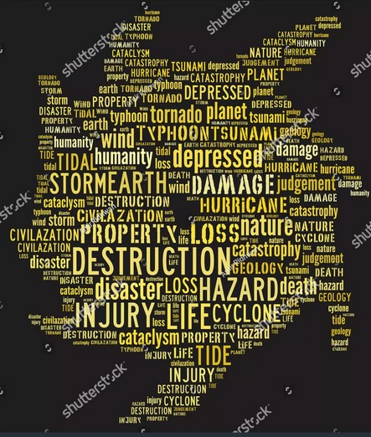
Contents:-
Introduction to Natural Calamities
Some Recent Natural Hazards
Who is responsible for it ?
Why we are so unconcern about it ?
How are we effecting ?
How can we control Disaster ?
Conclusion

Slide 3
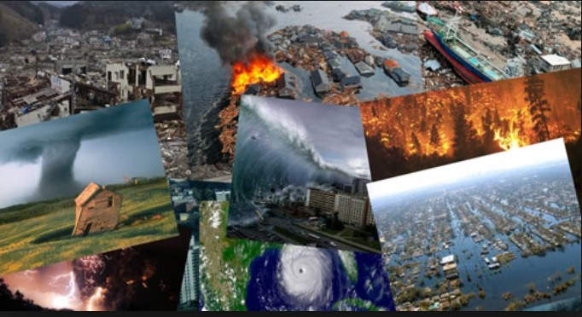
Introduction to Natural Calamities:-
It is a geological process that effect every human on the Earth all the time, but are most noticeable when they cause loss of life or property. If the process that poses the occurrence of hazard and destroys human life or property, then we say that disaster has occurred.
A natural disaster is defined by the UN as: “the consequences of events triggered by natural hazards that overwhelm local response capacity and seriously affect the social and economic development of a region.
Natural Disaster :- Hurricanes, Cyclones, Earthquakes, Tornados, Floods, Tsunamis, Droughts, Volcano Eruptions etc.
Man-made Disaster :- Nuclear Accident, Chemical Spill, Conflicts, Major fires, etc.

Slide 4
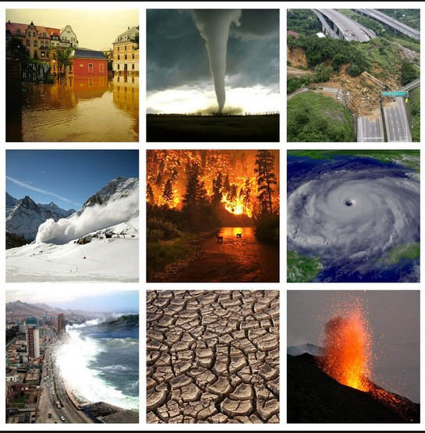
Some Recent Natural Hazards :-
California Wildfire,
Huricane Michael in USA,
Earthquake in New Guinea,
Japan Mud Slides,
India Dust Storms,
Kerala Floods,
Uttarakhand Floods,
Gujarat Eartquake, and
Odisha Super Cyclone

Slide 5
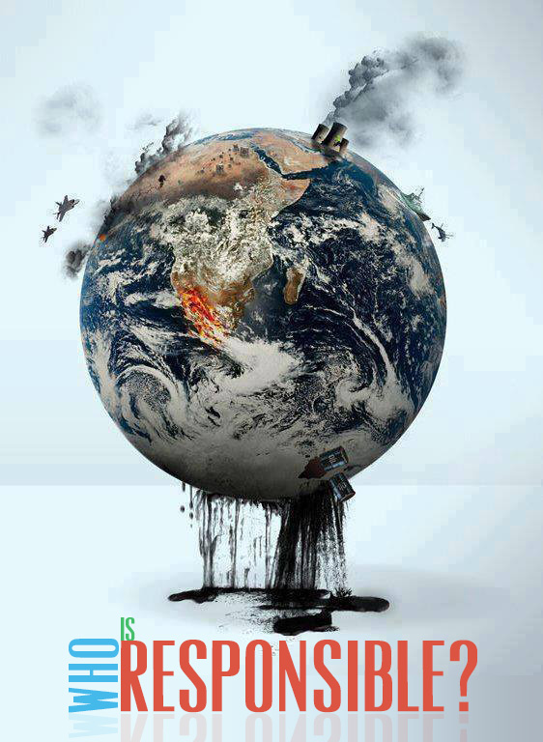
Who is Responsible for it ?
Answer to that is Mankind. It is responsible for every kind of disaster all around the globe. Human has always looked at nature in the way of just utilizing when needed. Since, Ancient times, going back to The Industrial Revolution, There is a constant shift in the way we live and look at nature. We pretend as if we are not from this planet. We are so careless that we can’t see the change in the environment. We pretend as if these changes are not real, it would somehow make it go away.
Why we are so unconcern about it ?
Human keeps a hostile attitude towards nature. Conquest of nature is the expression which is often used to denote man’s activities like deforestation, urbanization, and industrialization etc. which sums up man’s attitude towards nature.

Slide 6
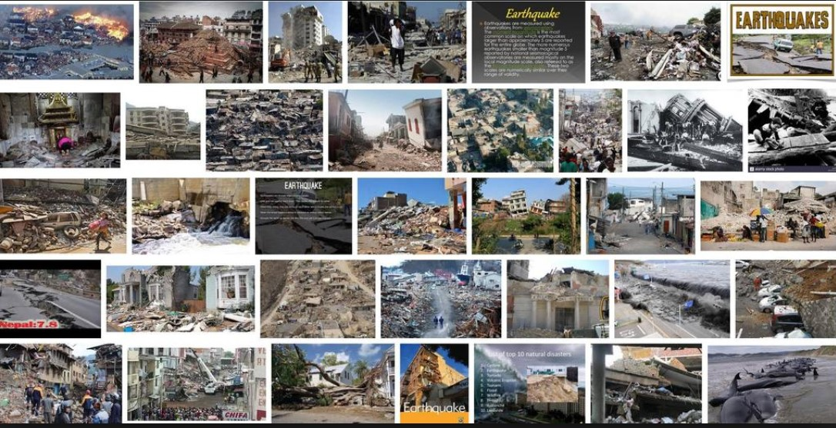
How are we effecting ?
Mass Production,
Mass Consumption, And
Massive Exploitation

Slide 7
For Example……..
Mankind have resulted in the process of climate change and it is the prime reason behind most of the natural calamities witnessed in the present world.
Global warming, which is converting into a slow onset disaster, is a result of human interference with nature.
Deforestation, Depletion of ozone layer, Landslides etc. have been giving warning to humans about the upcoming problems. Still, There are no considerable measures implemented to control the damage.
It is the mankind who carry on the development work in the areas prone to natural calamities.
The development is coming at the cost of nature. There is a growth in imbalance, leading to a rise in natural calamities.

Slide 8
How can we control Disaster ?
We should take proper initiative as, not to disturb the Nature.
We should perform plantation.
We should take care of our surroundings by not polluting it.
We should not disturb geological cycle of Nature.
We should try to aware people in our surroundings of the consequences of mass consumption, mass production, and massive exploitation of Nature.
We should implement strong rules and prohibition for the concern towards conservation of nature.

Slide 9
Conclusion:-
As global populations increase, people are more likely to live in disaster-prone areas and thus be at higher risk of being affected.
There is a need to change perception of life. It cannot be decided who is generally responsible for natural calamities, but measures can be taken to control the damage. It is necessary to remember from the ancient times, When life was seen as integral part of the natural scheme wherein humankind was given an opportunity to work for the benefit of the entire universe without disturbing or playing with it.

Slide 10
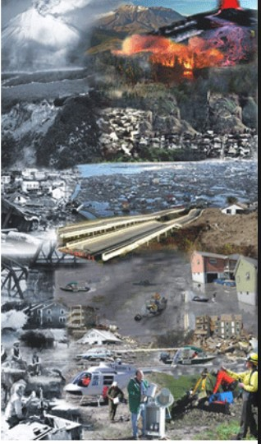
Mankind is a study of man contributing to environmental conflicts.
Land-slides, soil erosion and cloud burst, etc. are a creation of intensional human behaviour.
An economy that eats away the entire ecosystem.
A New Rays is needed to Begin….!!!!
Thank You
The Natural Calamities are invented and invited by us. So calling a calamities is a myth i.e., a miss-match. Because These are all man-made.
Note:- Human race will wipe out like dinosaurs. As if Bhagwad Gita couldn’t convince us, of what Karma is , The Nature acting against us, will surely do. So, Better Make a Balance in Biosphere.

